Slide 1
IoT Project
NASpberry
Home made NAS
IoT
pi 4
Julien VEAUX & Adrien GARCIA

Slide 2
PROJECT STEPS
01
04
Create the physical NAS
Data transmission
02
05
Set up of the OS
Security
03
06
Set up of OMV
Sensors for temperature
Set up of connections between all the components
Carry out data transmission between PC/Smartphone and the NAS
Install the OS on the raspberry and do all the configuration
Addition of a security aspects
Install OMV and do all the configuration steps
Measure temperature of both NAS CPU and HDD

Slide 3
Challenge and Motivation

Slide 4
01 - PHYSICAL NAS

Slide 5
COMPONENTS
SEAGATE NAS Ironwolf
Cooler master pi Case40
MeanWell RS-25-5
source map
Alimentation cable
Raspberry pi 4

Slide 6
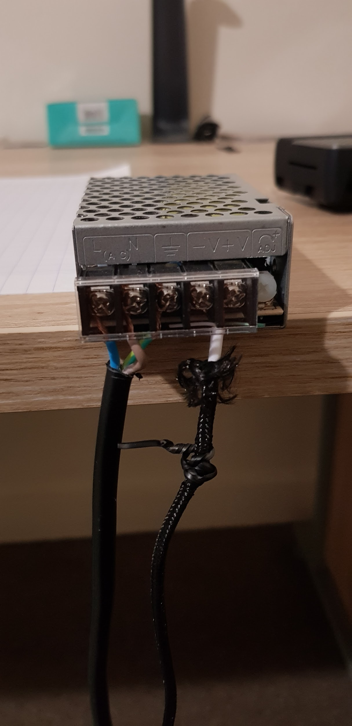
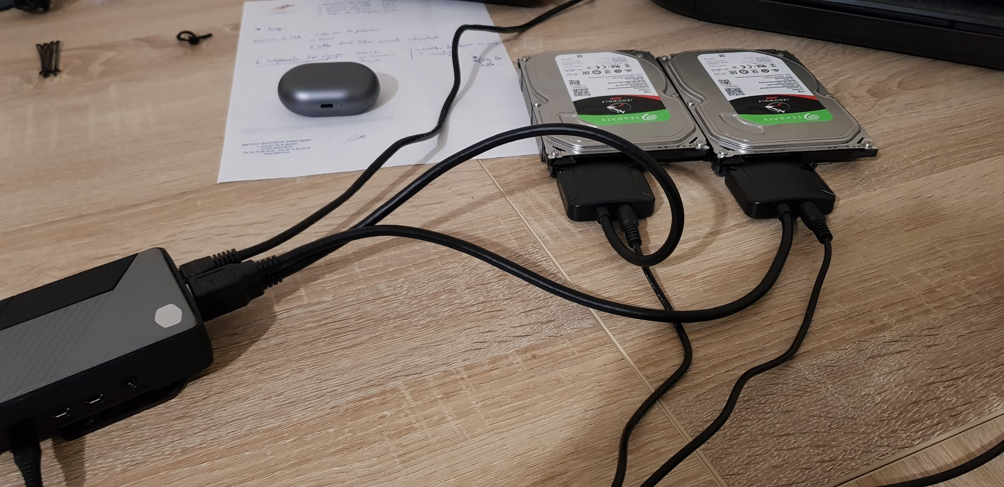
COMPONENTS

Slide 7
02 - OS SET UP

Slide 8
REQUIREMENTS
FLASH THE OS
ENABLE SSH CONNEXION
PLUG SD CARD IN THE PI
Put the OS image on a micro SD card
This step will allow us to control the NAS remotely
We’re now ready to set up the OS

Slide 9
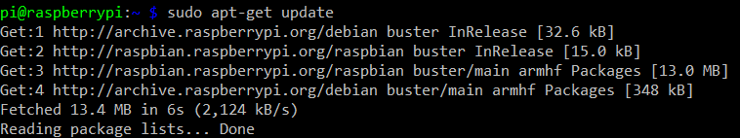
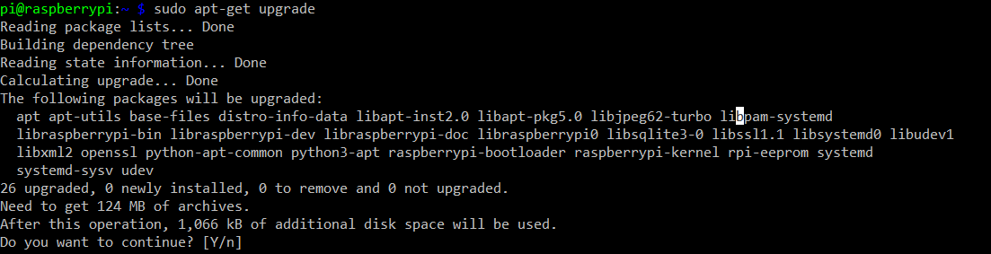
UPDATE THE SYSTEM

Slide 10
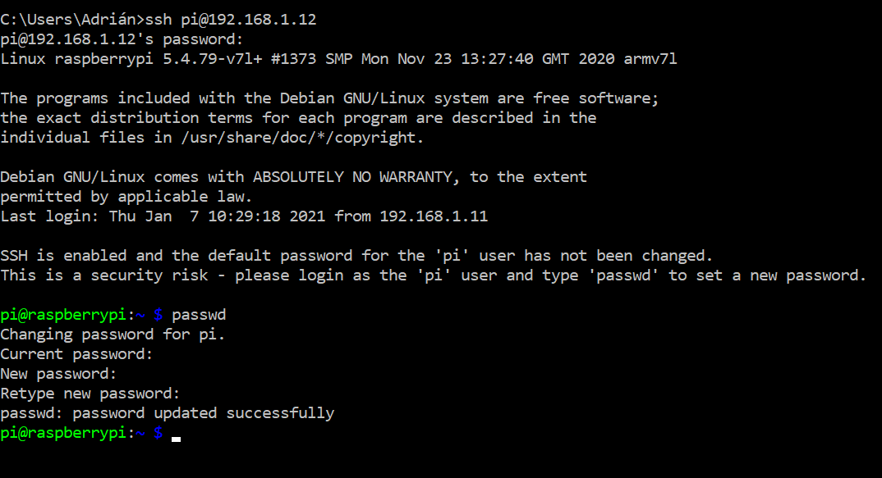
CHANGE THE PASSWORD

Slide 11
03 - OMV SET UP

Slide 12
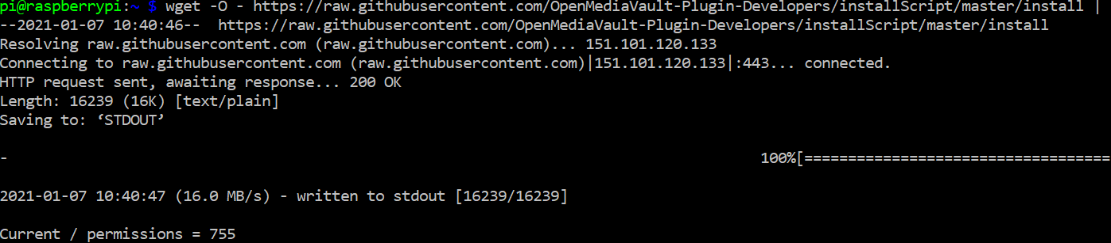
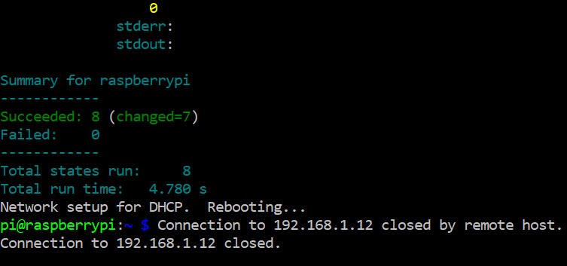
INSTALL OMV

Slide 13
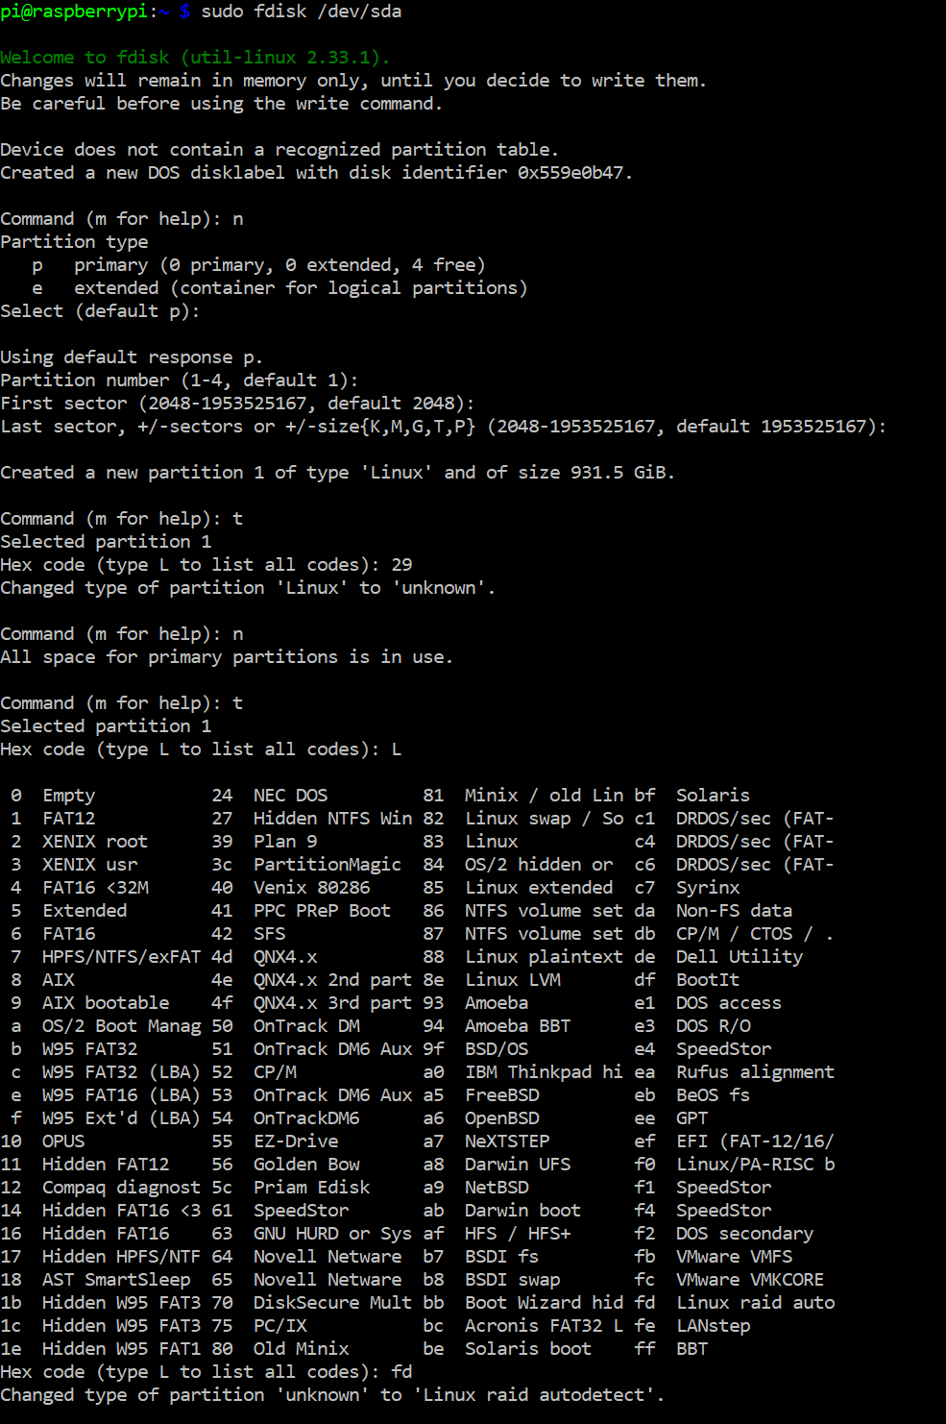
PARTITION THE DISKS

Slide 14
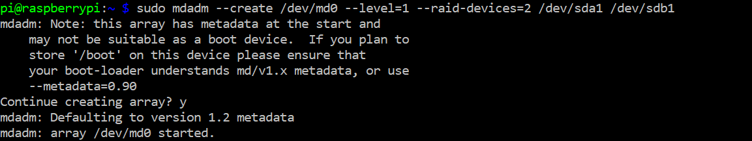
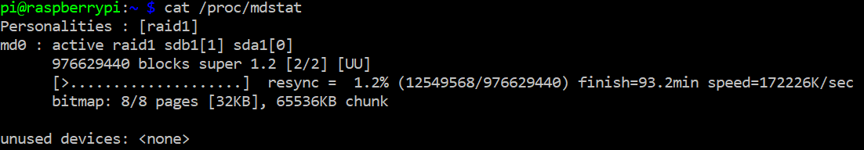
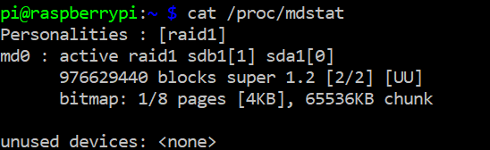
SET RAID 1

Slide 15
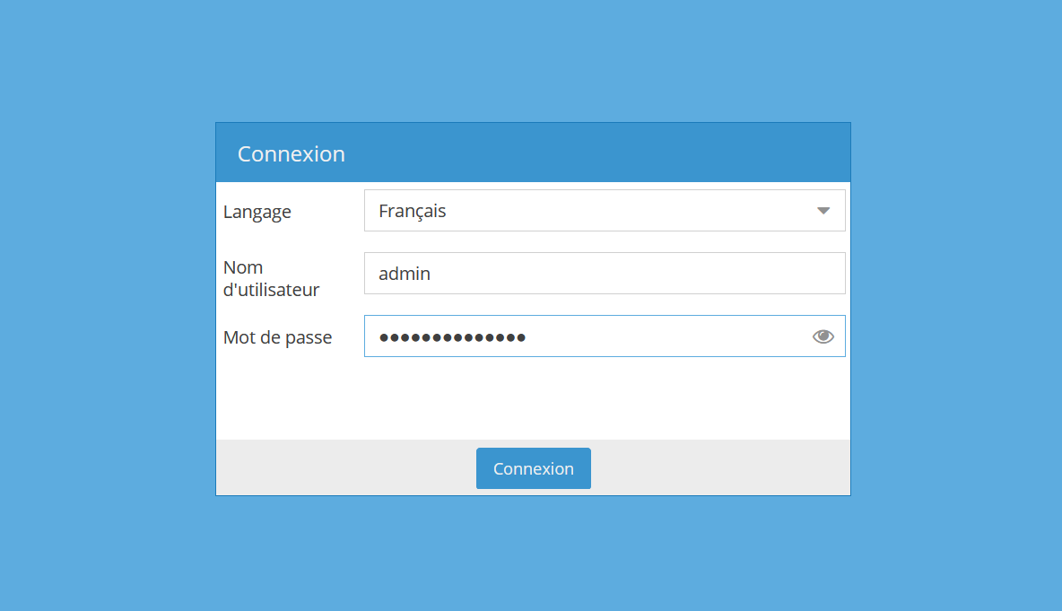
OMV INTERFACE

Slide 16
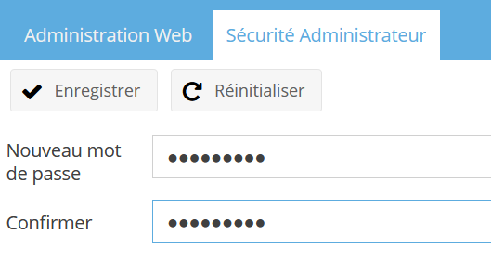
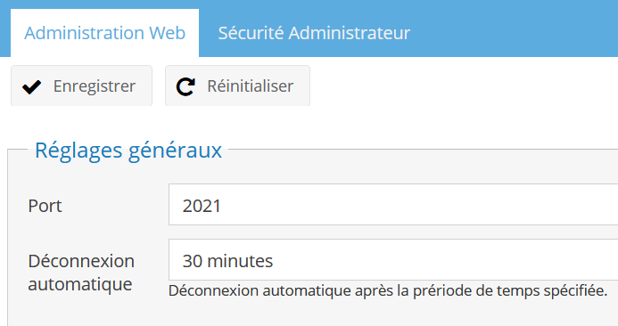
CHANGE PASSWORD AND PORT

Slide 17
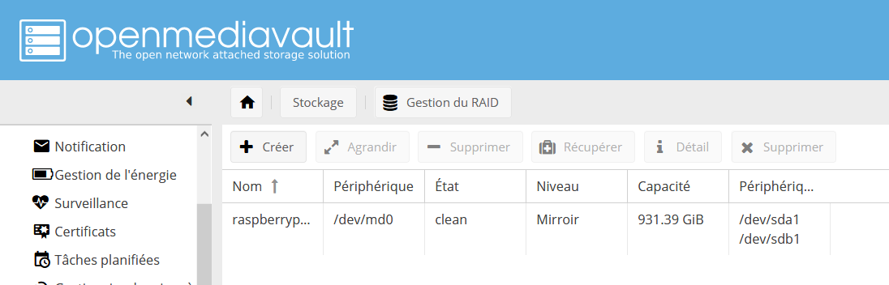
CHECK RAID DISK

Slide 18
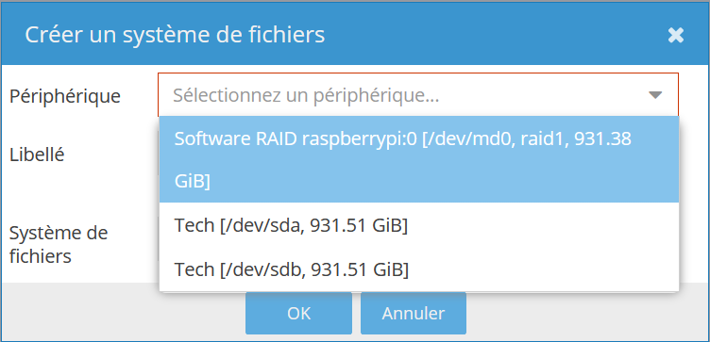
CREATE A FILE SYSTEM

Slide 19
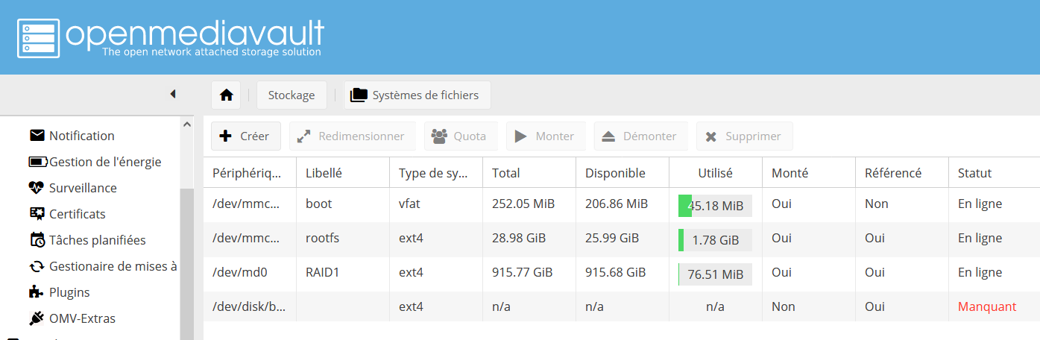
MOUNT RAID DISK

Slide 20
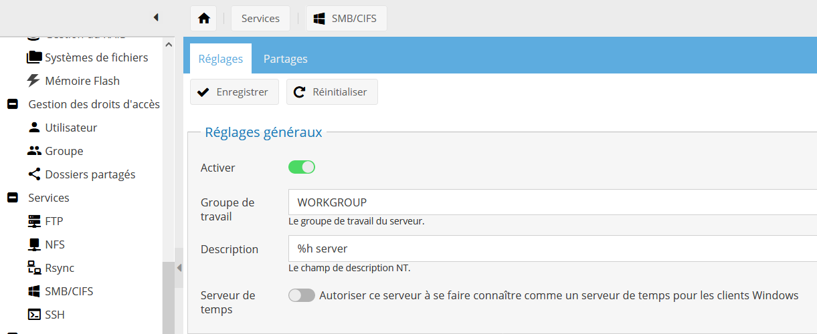
ENABLE SAMBA

Slide 21
04 - DATA TRANSMISSION

Slide 22
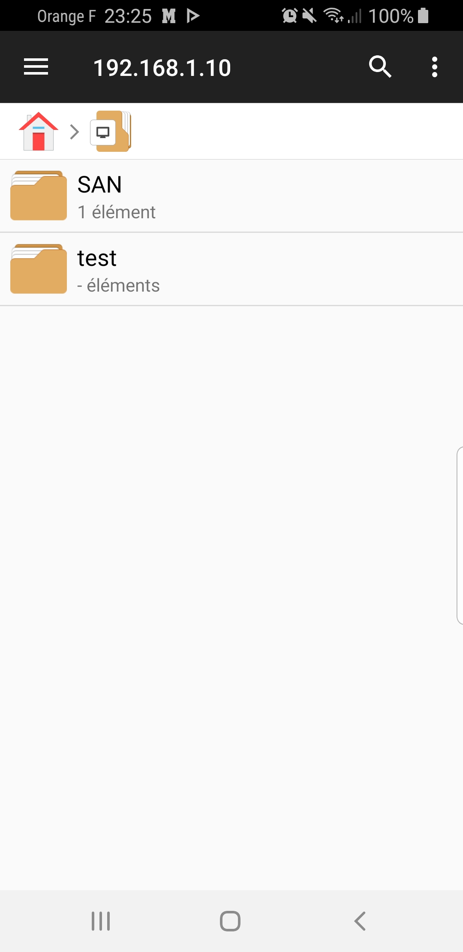
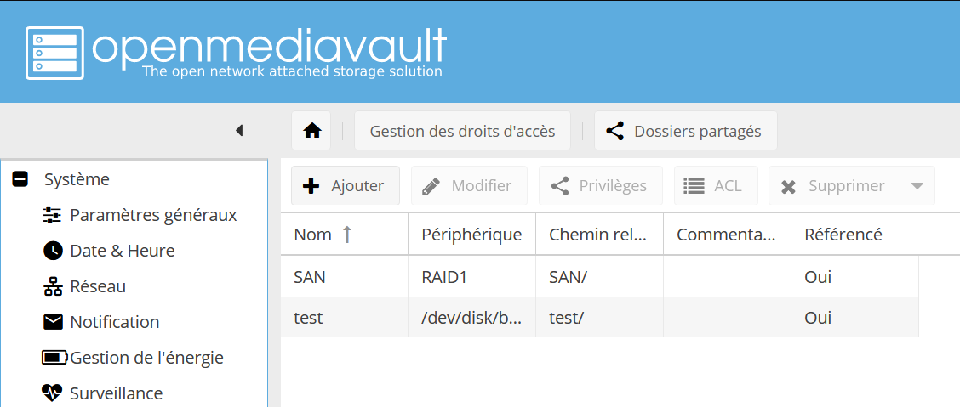
SHARE A FILE

Slide 23
05 - SECURITY

Slide 24
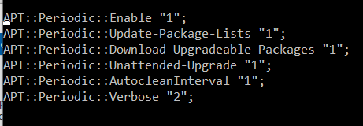
AUTO INSTALL OF SECURITY UPDATES

Slide 25
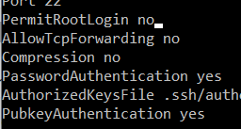

RESTRICT SUDO AND ROOT

Slide 26
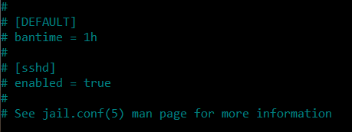
FAIL2BAN

Slide 27
WAYS TO IMPROVE
Install a firewall
Periodically prepare a backup
Encrypt connexions
Use a VPN

Slide 28
06 - TEMPERATURE

Slide 29
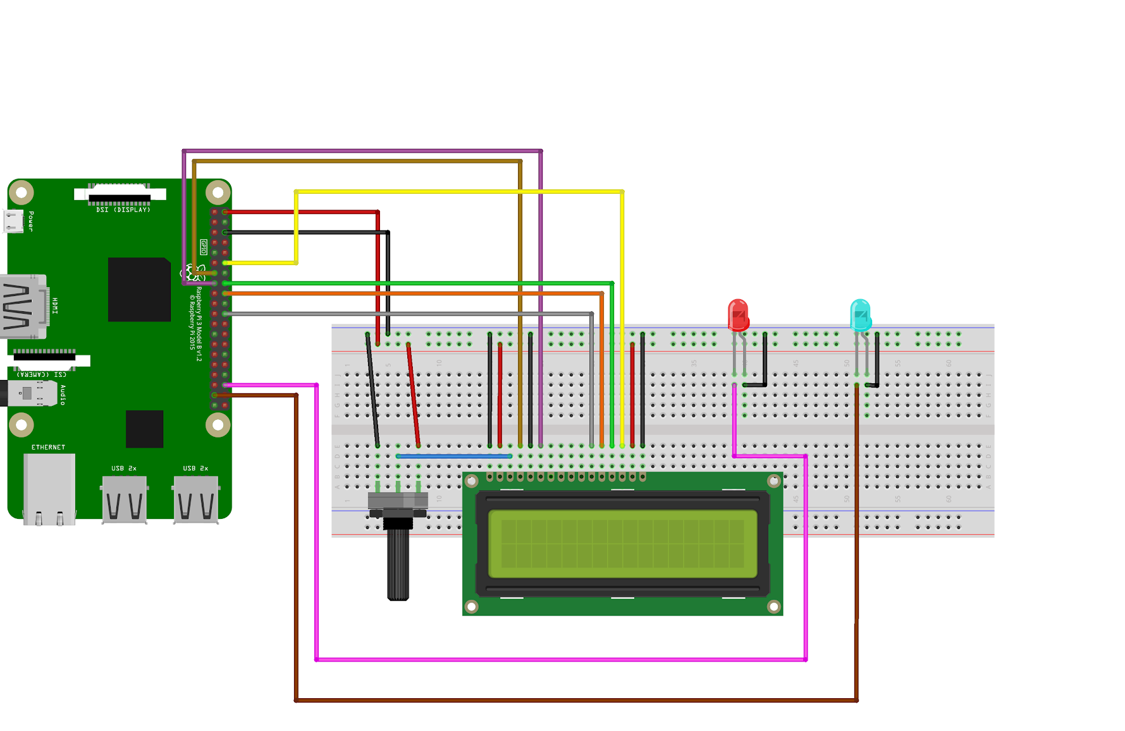
Connecting LCD display
Temperature

Slide 30
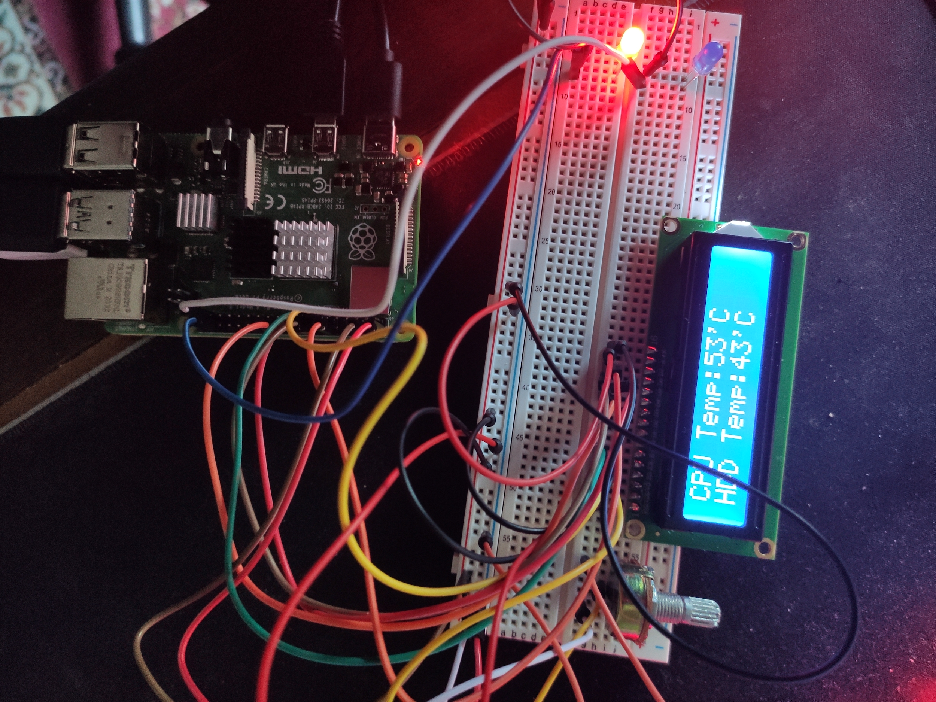
Final result

Slide 31
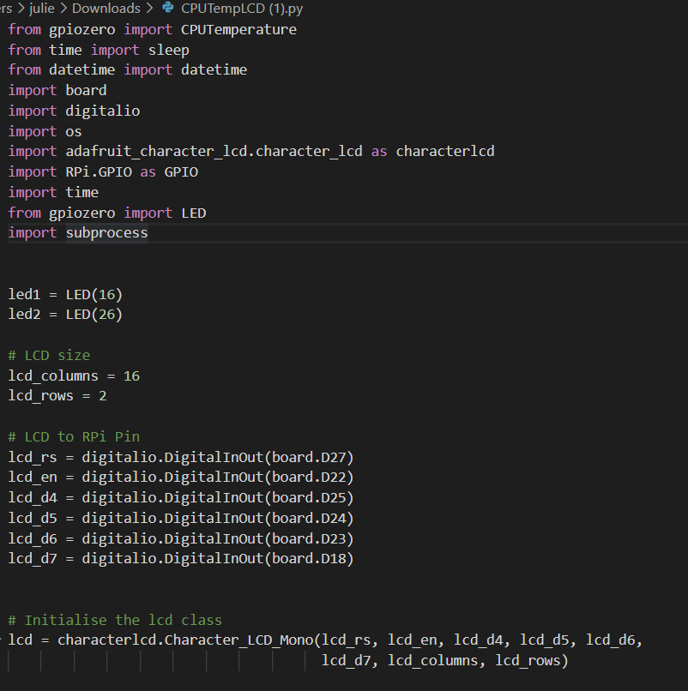
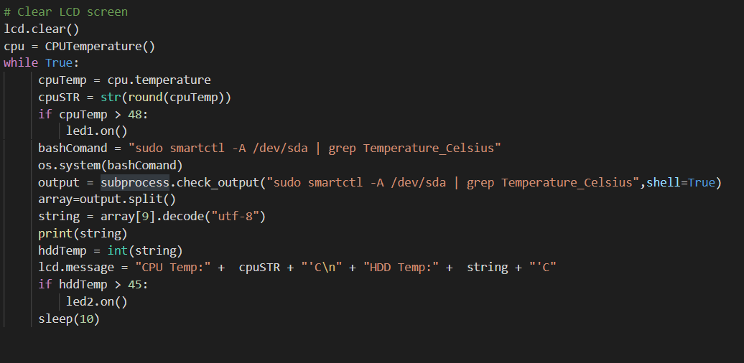
Our code

Slide 32
Our contribution
Adrien:
Flash OS
OMV set up
Data Transmission
Security
Julien:
Flash OS
Sensors montage and code
Video editing
We both bought a Raspberry pi 4
and worked on the OS

Slide 33


Slide 34
THANKS!
Does anyone have any question?

