Slide 1


Project : Internet of Things
Team E : Nice For What
Pauline TRUONG
Billy CHHUON

Slide 2
Description of Scale+
Scale+ is a connected body scale that reads the weight
using sensors and will be able to send data in a dashboard

Slide 3
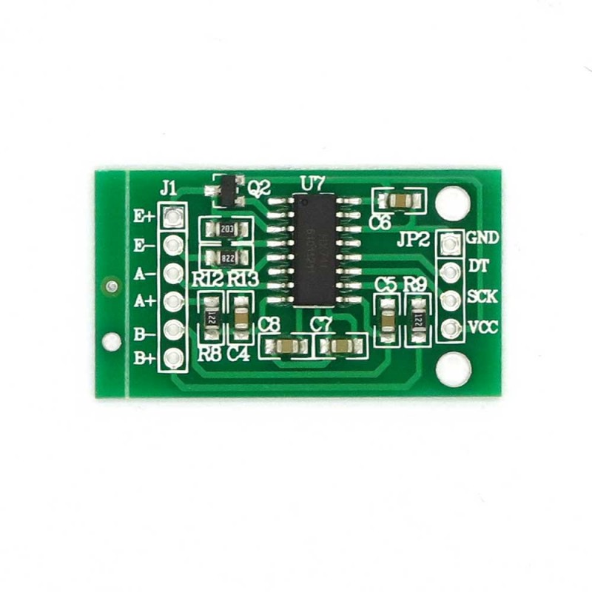
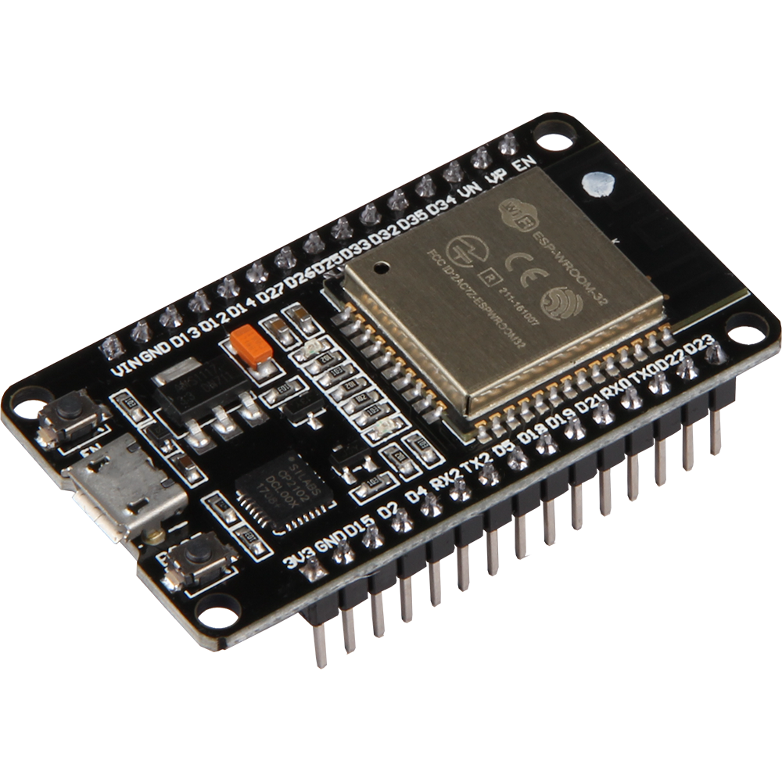
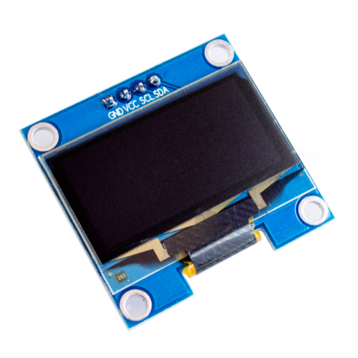
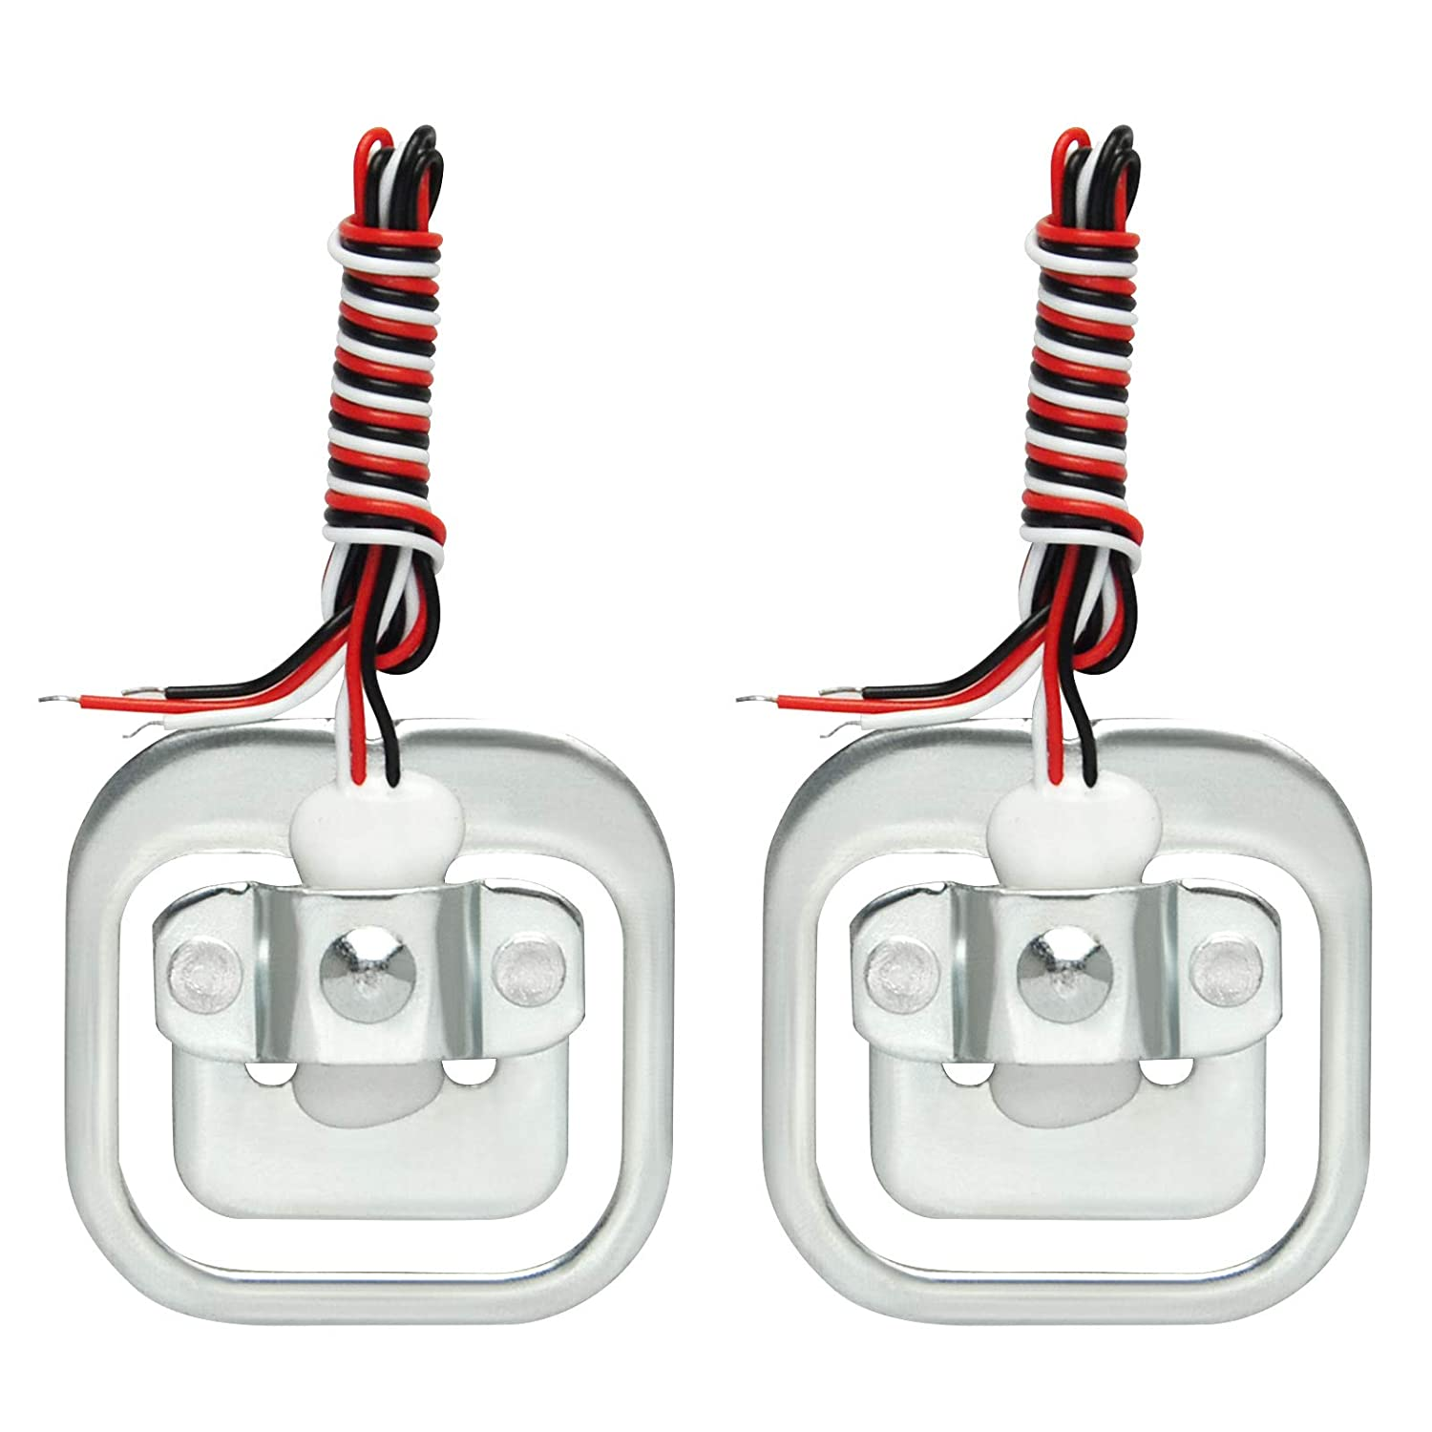
Main components
ESP 32
HX711
OLED display
Load Cells

Slide 4
What is a Load Cells
For a body scale, we need to use 4 loads cells of 50kg each
A Load cell is a metal force transducer that have
strain gauges glue to them
3 wires to provide power, ground and sensor reading
make the pressure here
Notes:
To talk a little bit about load cells, basically they are a strain gauge that covered with some glue
and comming out of that is three wires :
2 wires to provide power and ground and another for the sensor reading.
Strain gauge is kind of a potentiometer and depends on what is put on the load cell we can determine some sort of variance which is converted into some weight weither is grams, kilo ou ounces whatever we want.
As you can see on the load cell, we have a inside square and a ouside square and it is important when we fix the load cells on the scale to fix them on a sort of support because the inside square is actually flexes and need some space between the ground and the scale to flex up and down inward otherwise the scale won’t read the weight. So it is thanks to the pressure on this piece that the scale works.

Slide 5
What is a HX711
A HX711 is a module amplifier transducer that reads analogue value and convert in a digital value
HX711 get small voltage variation from a sensor
using Wheastone bridge principle
Connecting HX711 to ESP32 will help to read changes in the resistance of the force transducer with precise calibration obtain very accurate weight measurements
Notes:
A HX711 is a module amplifier transducer that reads analogue value and convert in a digital value.
The objective for the HX711 is to get small voltage variations from a sensor here is the load cell, operating on the Wheastone bridge principle we will see later.
Now, let’s have a look to the component.
We can see on the left side some letters. These are connecting with the scale.
So E+ and E- are the excitations and A+ and A- are for the amplifier. We didn’t need to connect to the B+ or B- because it act as an optional input which is not connected to the strain gauge but it is used for grounding and protection against external electromagnetic interference.
The right side of the HX711 is used to connect with the ESP32. We have ground and vcc supplied by the ESP32 on the ESP vcc is 3,3V and any digital pin for Dout and Clock.
That’s why by connecting HX711 to ESP32 will help to read changes in the resistance of the force transducer with precise calibration obtain very accurate weight measurements.

Slide 6
Building the scale

Slide 7
Step 1 : Building the scale
List of materials to build the scale :
Solid wooden plank (33cm x 33cm)
4 load cells of 50kg
- Tape
- Special resistant glue
- Solder iron

Slide 8
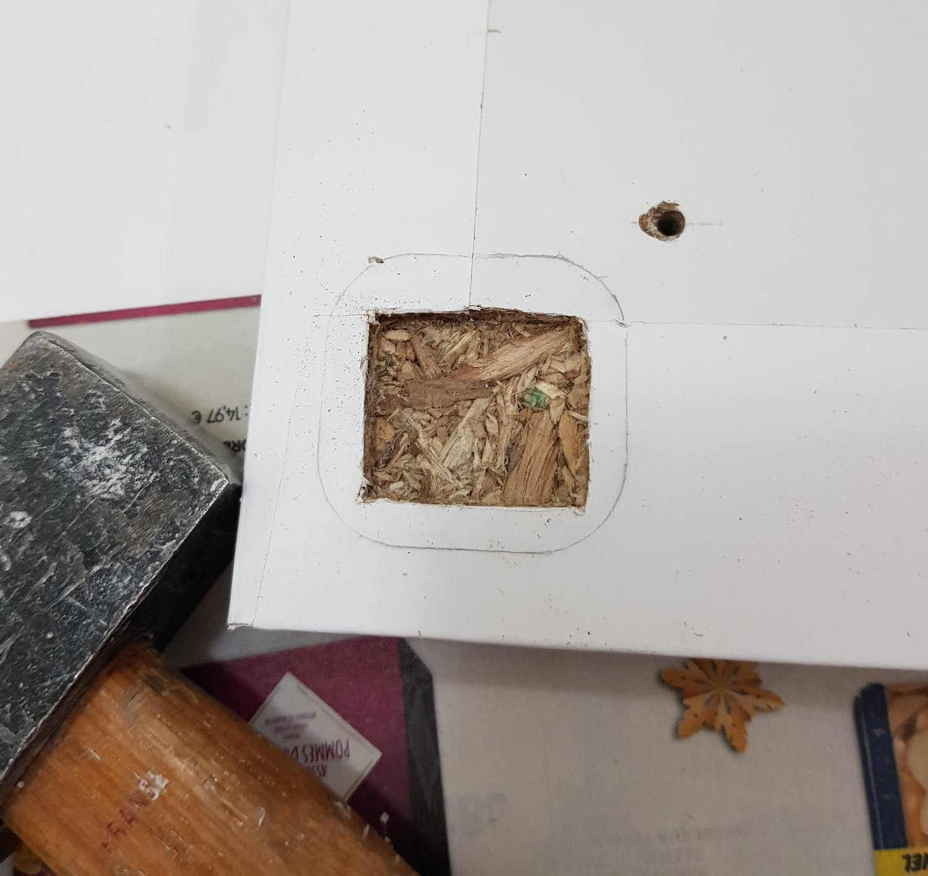
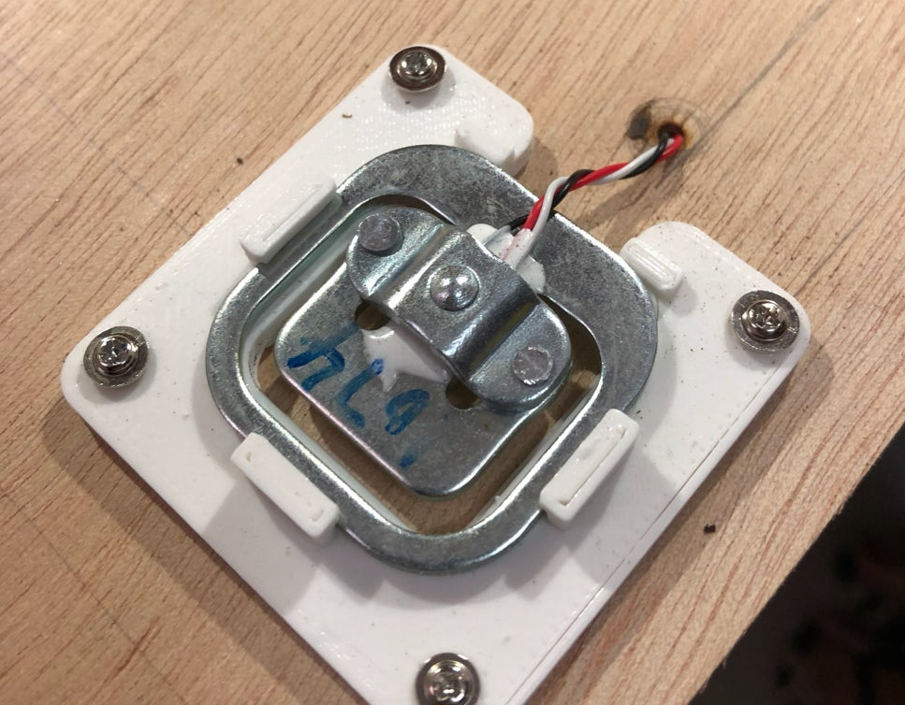
Step 1 : Building the scale
Make hole in all four corners of the scale and fix it with special resistant glue
Notes:
As you can see in the video and in the picture over here, we need to create a space for the inner square to flex up and down inward.
we had the first option to create with a 3D printer a support that hold the load cell but we didn’t have a 3D printer so we decided to drill a hole
directly in the wooden plank so the inner part of the load cell can flex and mesure the pressure and the variation.

Slide 9
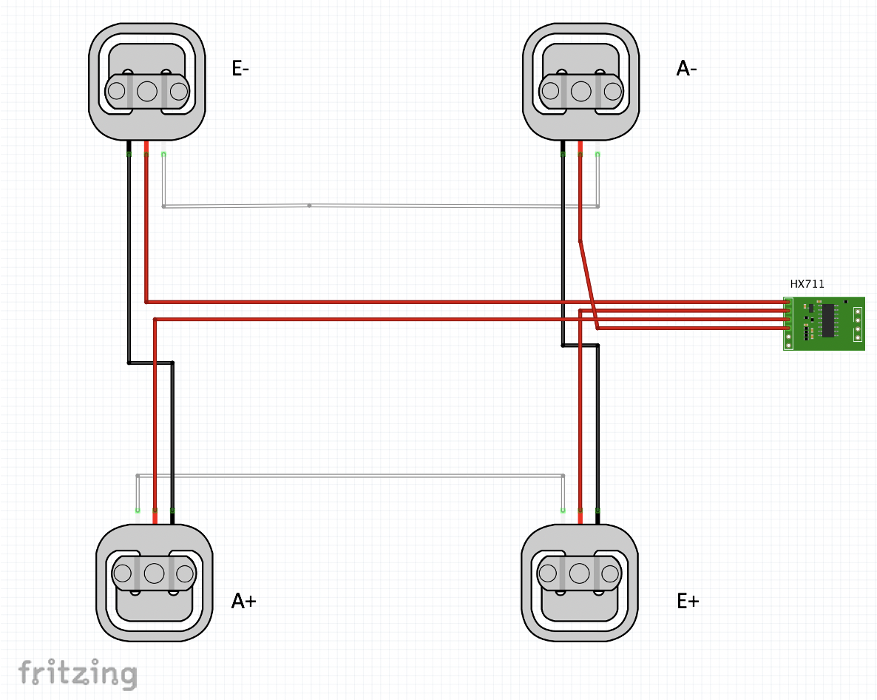
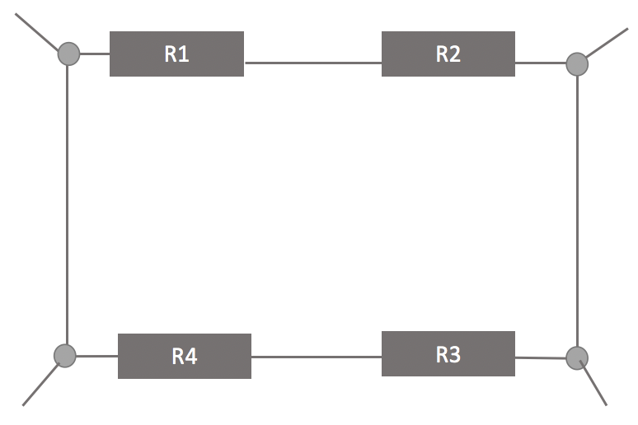
Step 1 : Building the scale
Load cells schematic
Wheatstone Bridge
Signal -
GROUND
Signal +
VCC
Notes:
This part is one of the most important for this scale project.
The four load cells need to be set up in this specific order in order to create a Wheatstone bridge. So we have those 4 sensors.
So E- is going to represent the excitation ground, the sensor E+ represents the VCC, the sensor A+ represents the sensor positive and A- represents the sensor negative.
Also we need to connect the back wires the ground one from lower to upper and the white wires from the left to the right and we will use the red to connect to the HX711.

Slide 10
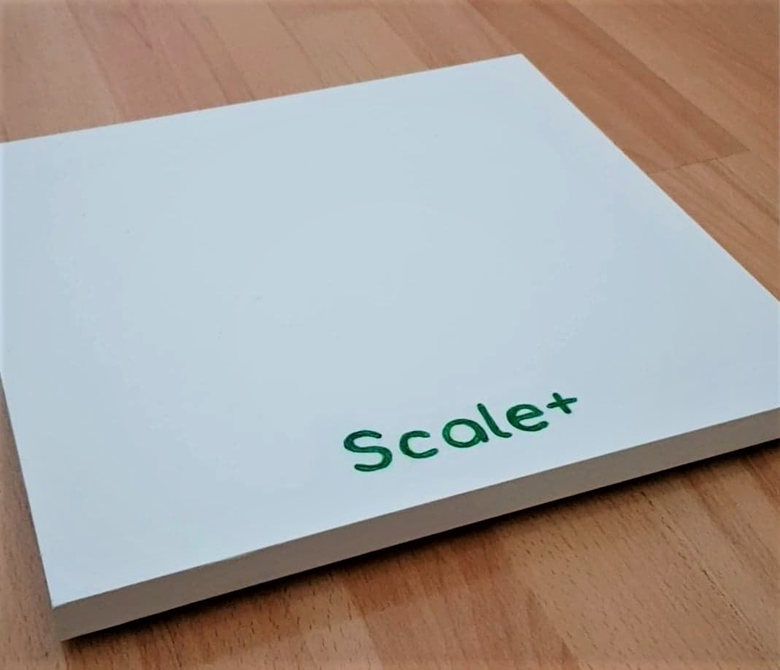
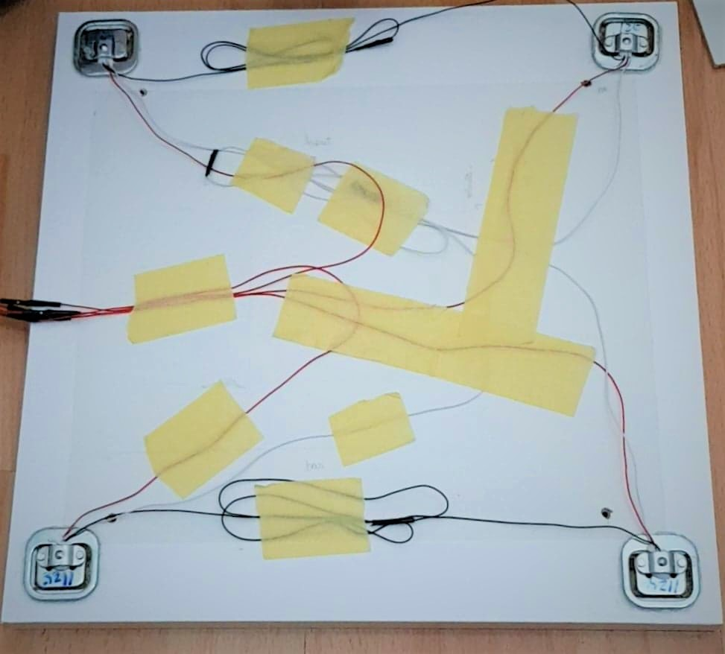
Step 1 :Building the scale
Result of the building part

Slide 11
OLED Display
Notes:
Now that the scale is build, we want to display the weight on a OLED screen.
To do so, we follow the schematic

Slide 12
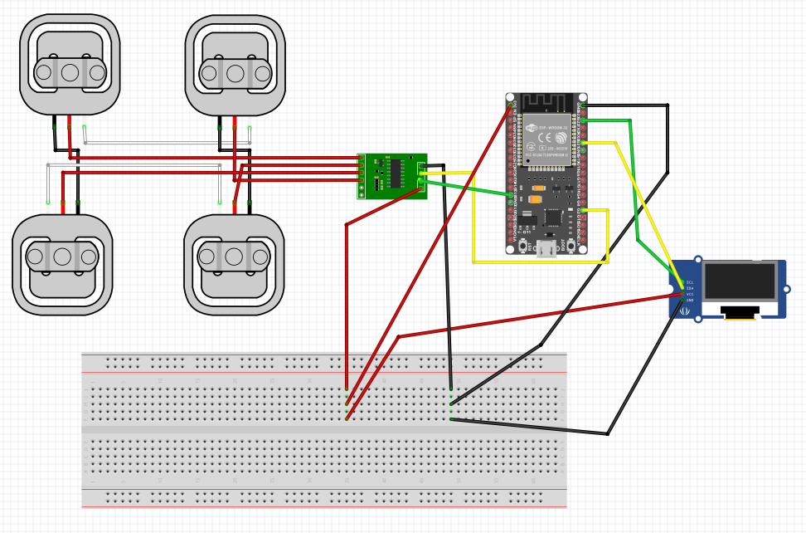
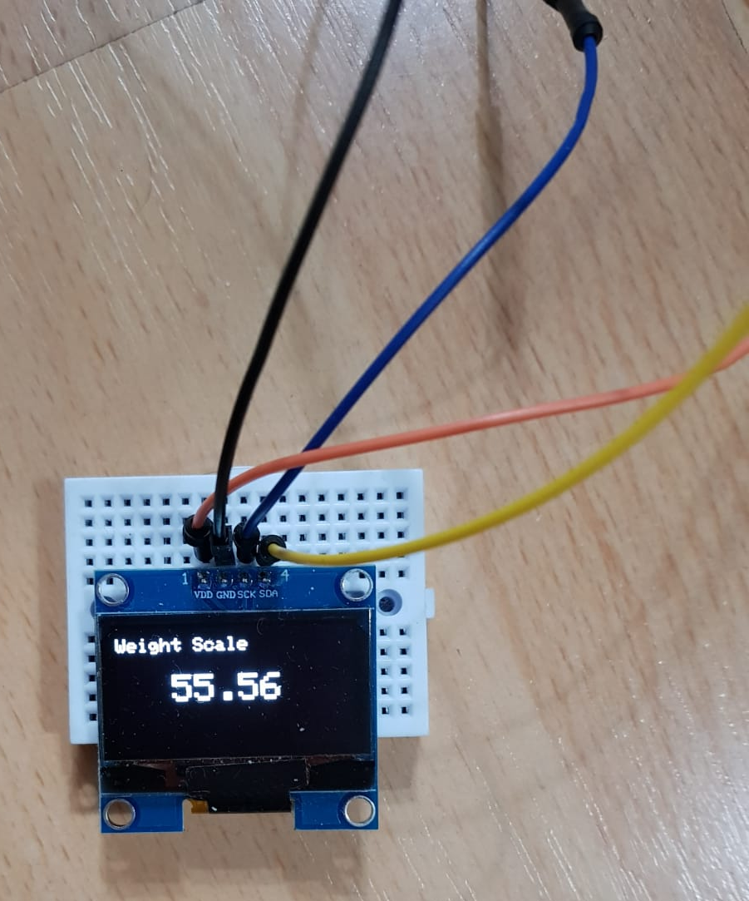
Step 2 :
OLED display
OLED display schematic
Notes:
Oled has four pins : ground, vcc and also Dout and clock.
In oled, dout and clock pins need to be chose carefully depending on the oled condition. So we chose, pin 21 for dout and pin 22 for clock.

Slide 13
Scale calibration
Notes:
After connecting all the wires together with the OLED, we will test our scale and see if it reads any weight.
Before any manipulation, we first need to calibrate the scale.
Calibrate the scale means that we first need to set up the scale to 0kg with no weight on the scale.

Slide 14
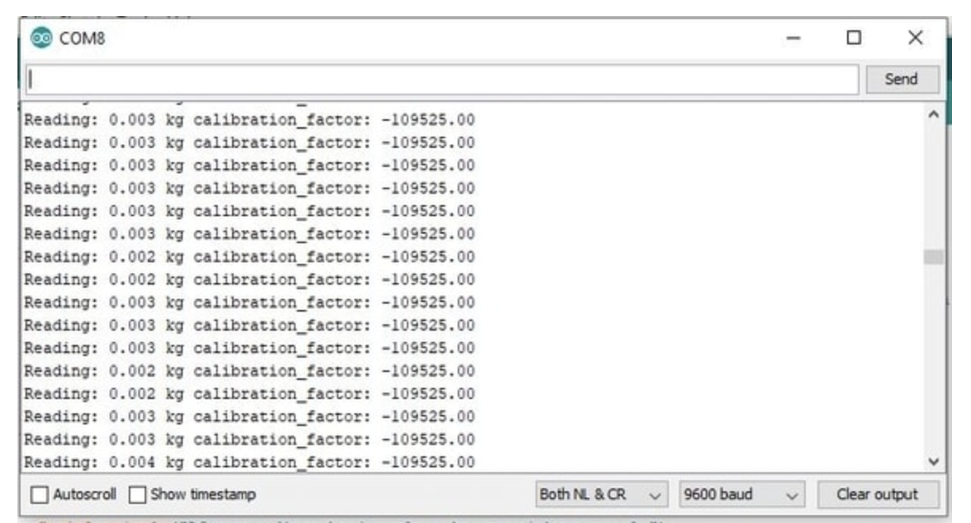
Step 3 : Scale calibration
Compile the code
Look at the value on the serial monitor
3. Increase and decrease the reading value to obtain 0.000 kg
Notes:
To calibrate our scale, we will use a program we found. So first we will compile the code and look at the value on the serial.
We will see a lot value close to zero but not the exact value.
We will then adujust the value by increasing or decreasing the reading value to obtain 0.00kg.
When it is done, we will record the calibration factor and put it on the main code.
Now we have correctly calibrate our scale.

Slide 15
Connection with Thingspeak

Slide 16
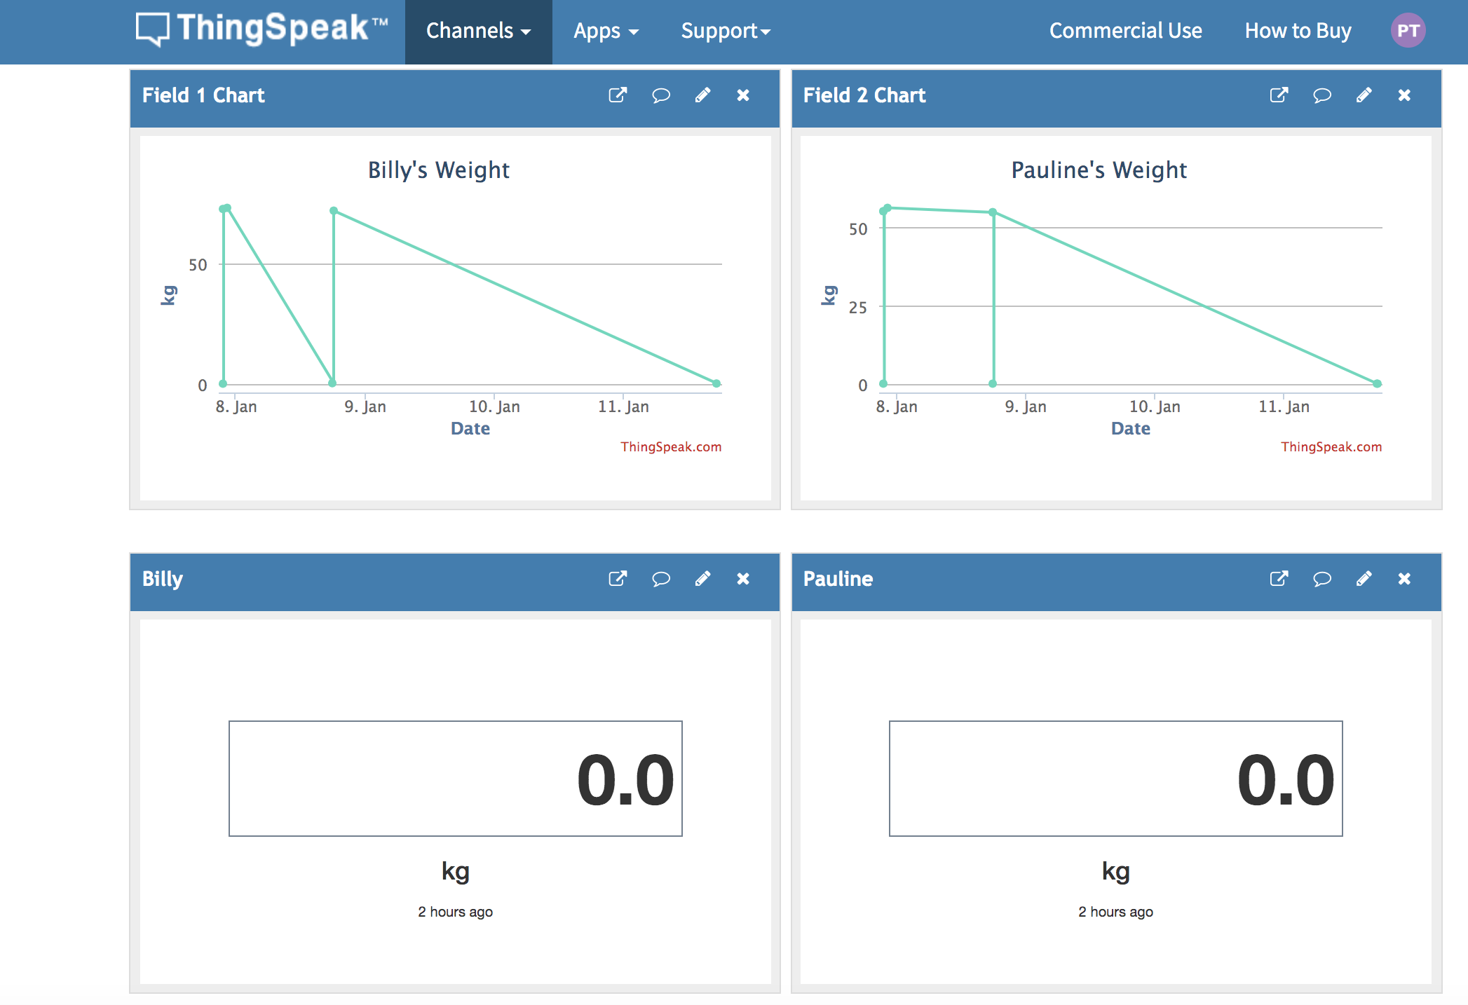
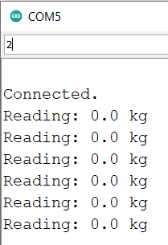
Step 3 : Connection with Thingspeak

Slide 17
Main difficulties encountered

Slide 18

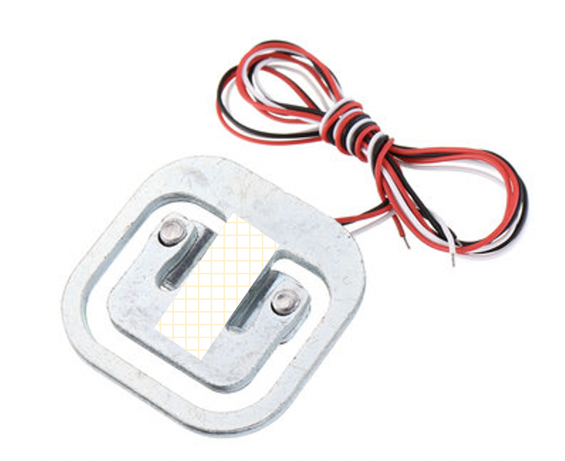
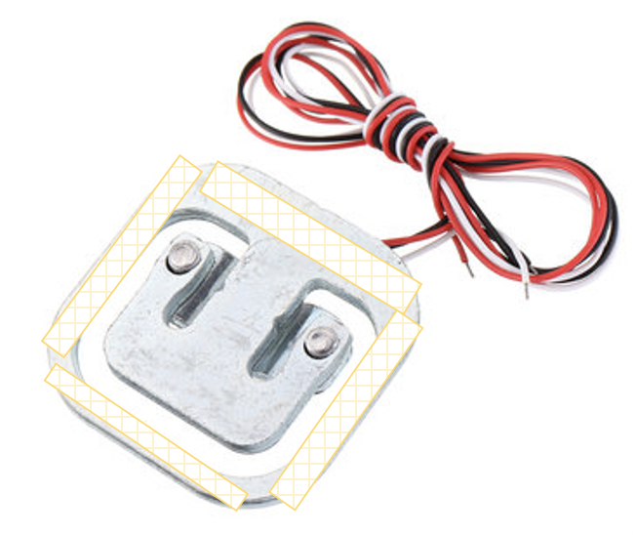
Main difficulties encountered
Scale does not detect
any pressure
Weight reading is unstable
Fixation 1
Fixation 2

Slide 19

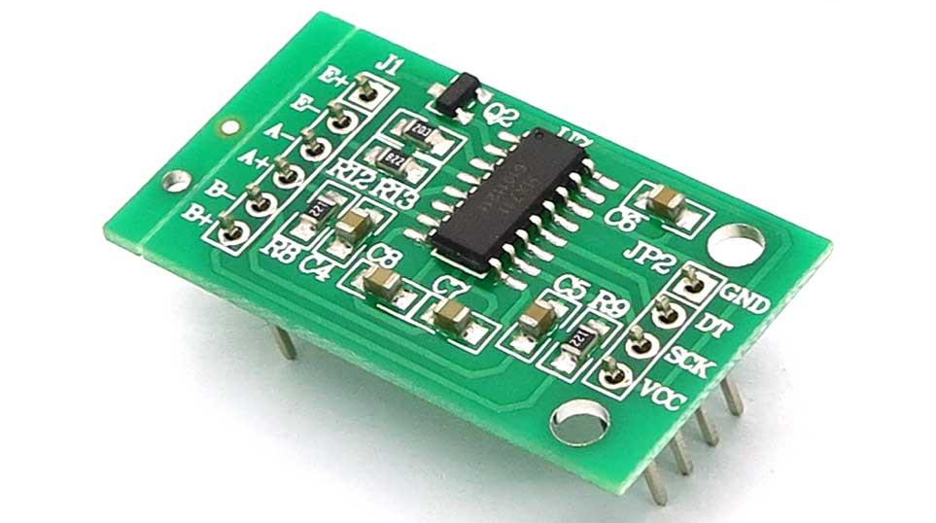
Solution
Make hole in all four corners of the scale
Fix with special glue
Soldered HX711 component

Slide 20
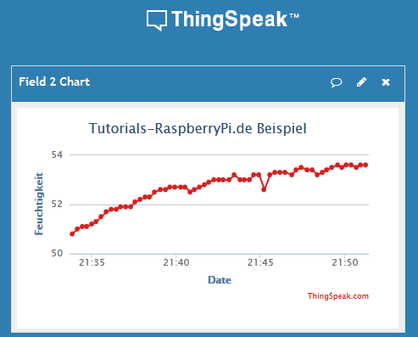
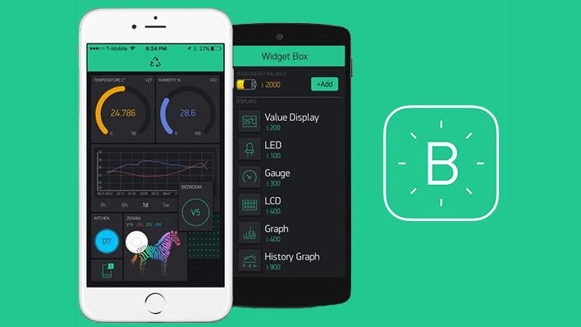
Main difficulties encountered
Adding many users to our scale

Slide 21
Coding part

Slide 22
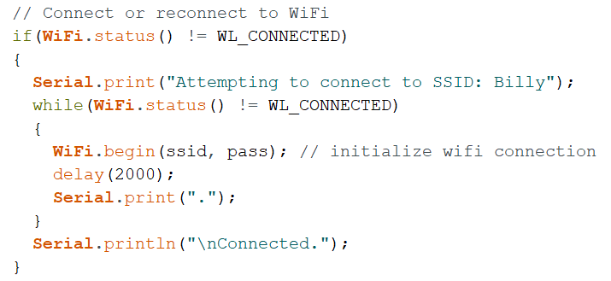
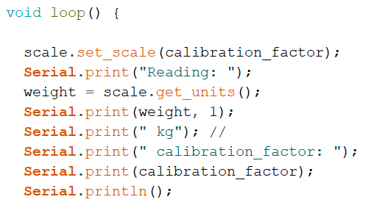
Coding part
Reading weight
Connection process

Slide 23
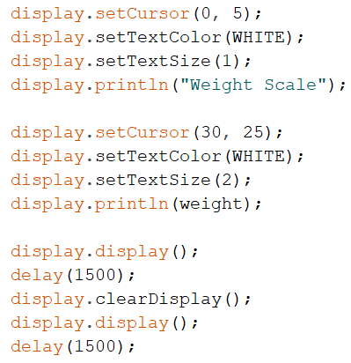
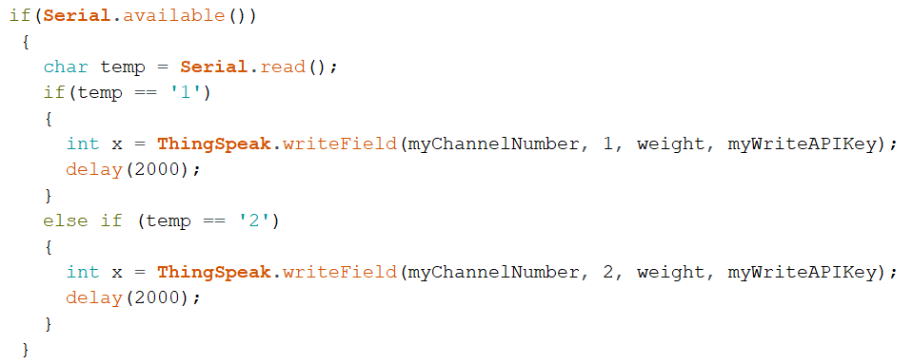
Coding part
OLED display
ThingSpeak User 1 & 2

Slide 24
Demonstration of Scale+

